Slide 1



Noida Institute of Engineering and Technology, Greater Noida
Object Oriented Techniques using Java(ACSE0302)
Unit : 1
Introduction
B.tech 3rd Sem
Surbhi Jha
Assistant Professor
CSE Department

Slide 2
Faculty Profile
Experience | Details
Teaching Experience | 4th January to till now Subject Taught/Lab: M.Tech AI Lab in Python, Design Thinking, OOT using JAVA Subject Interest: Artificial Intelligence, Python
Industrial Work Experience | 2.6 Years Worked as Configuration Management Engineer and Network Integration Engineer in 3G and 4G Technology at Nokia, Sector-62, Noida (21 Jan 2016 to 20 July 2017) Worked as Fault Management Engineer inEricsson, Sector-62,Noida(2 Feb 2015 to 20 Jan 2016)
Education Background | Details
M.Tech in Computer Science Engineering(2017-19) | Gautam Buddha University, Greater Noida
B.Tech in Computer Science Engineering(2011-15) | I.T.S Engineering College, Greater Noida

Slide 3
Faculty Profile: Coursera Achievements
Artificial Intelligence in Marketing certified on Certified on 05Oct2021: 4-5 week online non-credit course authorized by University of Virginia and offered through Coursera
Machine Learning Foundations for Product Managers certified on Certified on 29Sept2021: 4-5 week online non-credit course authorized by Duke University and offered through Coursera
Human Factors in AI Certified on 26Sept2021: 4-5 week online non-credit course authorized by Duke University and offered through Coursera
Data Visualization with Python Certified on 24Sept2021: 4-5 week online non-credit course authorized by IBM and offered through Coursera
Human-Centered Design for Inclusive Innovation Certified on 24Sept2021: 4-5 week online non-credit course authorized by University of Toronto and offered through Coursera
Introduction to Psychology Certified on 21Sept2021: 4-5 week online non-credit course authorized by Yale University and offered through Coursera
Machine Learning with Python Certified on 18Sept2021: 4-5 week online non-credit course authorized by IBM and offered through Coursera
Deep Learning and Reinforcement Learning Certified on 18Sept2021: 4-5 week online non-credit course authorized by IBM and offered through Coursera
Specialized Models: Time Series and Survival Analysis Certified on 18Sept2021: 4-5 week online non-credit course authorized by IBM and offered through Coursera
Data Analysis with Python Certified on 18Sept2021: 4-5 week online non-credit course authorized by IBM and offered through Coursera
Supervised Machine Learning: Classification Certified on 14Sept2021: 4-5 week online non-credit course authorized by IBM and offered through Coursera
Unsupervised Machine Learning Certified on 14Sept2021: 4-5 week online non-credit course authorized by IBM and offered through Coursera

Slide 4
Faculty Profile: Coursera Achievements
Supervised Machine Learning: Regression Certified on 12Sept2021: 4-5 week online non-credit course authorized by IBM and offered through Coursera
Exploratory Data Analysis for Machine Learning Certified on 09Sept2021: 4-5 week online non-credit course authorized by IBM and offered through Coursera
Tools for Data Science Certified on 07Sept2021: 4-5 week online non-credit course authorized by IBM and offered through Coursera
Python Project for Data Science Certified on 06Sept2021: 4-5 week online non-credit course authorized by IBM and offered through Coursera
Artificial Intelligence for Breast Cancer Detection Certified on 06Sept2021: 4-5 week online non-credit course authorized by Johns Hopkins University and offered through Coursera
Data Science Methodology Certified on 05Sept2021: 4-5 week online non-credit course authorized by IBM and offered through Coursera
Building AI Powered Chatbots Without Programming Certified on 03Sept2021: 4-5 week online non-credit course authorized by IBM and offered through Coursera
Getting Started with AI using IBM Watson Certified on 02Sept2021: 4-5 week online non-credit course authorized by IBM and offered through Coursera
Artificial Intelligence Algorithms Models and Limitations Certified on 02Sept2021: 4-5 week online non-credit course authorized by LearnQuest and offered through Coursera
Artificial Intelligence on Microsoft Azure Certified on 01Sept2021: 4-5 week online non-credit course authorized by Microsoft and offered through Coursera
Introduction to Deep Learning & Neural Networks with Keras Certified on 28Aug2021: 4-5 week online non-credit course authorized by IBM and offered through Coursera

Slide 5
Faculty Profile: Coursera Achievements
Data Structures Certified on 28Aug2021: 4-5 week online non-credit course authorized by University of California San Diego and HSE University and offered through Coursera
Python for Data Science, AI & Development Certified on 19Aug2021: 4-5 week online non-credit course authorized by IBM and offered through Coursera
Python Basics Certified on 18Aug2021: 4-5 week online non-credit course authorized by University of Michigan and offered through Coursera
Introduction to Artificial Intelligence (AI) Certified on 14Aug2021: 4-5 week online non-credit course authorized by IBM and offered through Coursera
Introduction to Cloud Computing Certified on 13Aug2021: 4-5 week online non-credit course authorized by IBM and offered through Coursera
What is Data Science? Certified on 12Aug2021: 4-5 week online non-credit course authorized by IBM and offered through Coursera.
Programming for Everybody (Getting Started with Python) Certified on 11Aug2021: 4-5 week online non-credit course authorized by University of Michigan and offered through Coursera.

Slide 6
Faculty Profile: Extracurricular Activities/Publications
Participated in National Conference on “Recent Advances in Electronics & Communication Engineering” (RACE-2014) March 28-29, 2014 on the topic “ A Review of Diversity Techniques in Wireless Communication”. https://www.its.edu.in/RACE2016/RACE2014/finalpdfpapers/RACE1059.pdf Participated in TECHTRIX-2014 on the project name “shop around”. Paper published in STM JOURNALS (Perspectives of cloud computing management: An Overview) http://stmjournals.com/index.php?journal=JoCTA&page=issue&op=current

Slide 7
Faculty Profile: Conferences/Seminars/FDP
Data Analysis Using Excel from E & ICT Academy, IIT Kanpur
Attended National Workshop in Data Analytics with Python conducted by Code Scholar and taught by TCS team.
Attended FDP on “Recent Advances and Challenges in Nanoscale Devices: Design, Materials, and Application Perspective” at NIT, Hamirpur certified by AICTE Training and Learning (ATAL) Academy.
Attended One-week short-term training program on Data Science and its applications sponsored by AICTE in NIET, Greater Noida.
FDP on Machine Learning from ITS Engineering College, Greater Noida.
FDP on Data Science from EXCELR.
Participated in one week Faculty Development Programme on “Big Data Analytics” at Gautam Buddha University.
Participated in “Career Oriented Seminar” at Gautam Buddha University.
Participated in National Conference on “Recent Advances in Communication, Electronics &Electrical Engineering” (RACE-2015) March 27-28, 2015.
Participated in the Pre-Conference Tutorial Co- located with IEEE International Conference on Computer & Computational Sciences (ICCCS-2015).
Participated in National Conference on “Recent Advances in Electronics & Communication Engineering” (RACE-2014) March 28-29, 2014 on the topic “ A Review of Diversity Techniques in Wireless Communication”.https://www.its.edu.in/RACE2016/RACE2014/finalpdfpapers/RACE1059.pdf

Slide 8
Faculty Profile: Workshop
National Webinar on “Covid-19 & Related Technology Developed by Engineering Institutes” conducted by Department of Applied Sciences and Humanities, Rajkiya Engineering College, Mainpuri Attended 3-days National workshop on “NAAC Assessment and Accrediation: A Step by Step Process at ChadalawadaRamanamma Engineering College, Tirupathi-517506, Andhra Pradesh. Attended Workshop on startup opportunity for youth in 2021, to make India Atmanirbhar held at Galgotias Engineering College, Greater Noida. Attended workshop on National Innovation and Startup policy: Role of technical Institution in Technological Innovation & IPR creation in Nation Building held at Galgotias Engineering College, Greater Noida. Attended e-lecture on Pedagogical view of developing 21st-century problem solving and programming skills in budding IT professionals organized by Dr. A.P.J Abdul Kalam Technical University, Lucknow, U.P. Two days’ workshop on “Computational Nanotechnology and Nano electronics” organised by Dept. of Electrical Engineering, SOE, GBU, Gr. Noida. National Workshop on Optimization Techniques for Solving Multidisciplinary Research Problems in Engineering Sciences(OTSMRPES-2014). One day workshop on Linux from DUCAT. One day workshop on PHP from DUCAT. Workshop on MATLAB from I.T.S Engineering College.

Slide 9
Faculty Profile: Trainings/ Internship
Mapping Skills, Greater Noida
PythonBootcamp under the guidance of Mapping Skills.
Data Science and Machine Learning in Python
Vocational/Practical Training : MTA (Microsoft Training Associate) certified .NET:
Practical (vocational) training under the guidance of ATS Infotech
.NET Fundamentals
Web Development Fundamentals
Vocational/Practical Training : JAVA from DUCAT, Greater Noida:-
Practical (vocational) training under the guidance of DUCAT, Greater Noida.
Core JAVA
Advanced JAVA
Internship :C & C++, DUCAT, Greater Noida:
Basics of C & C++.

Slide 10
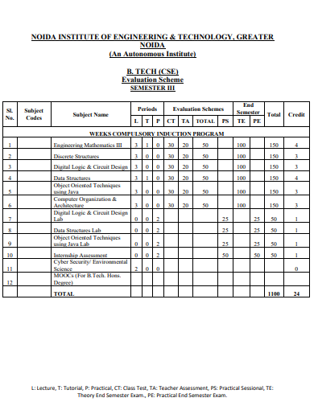
Evaluation Scheme

Slide 11
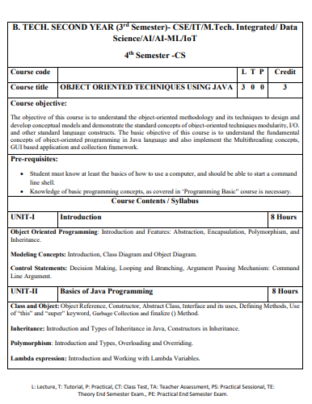
Syllabus

Slide 12
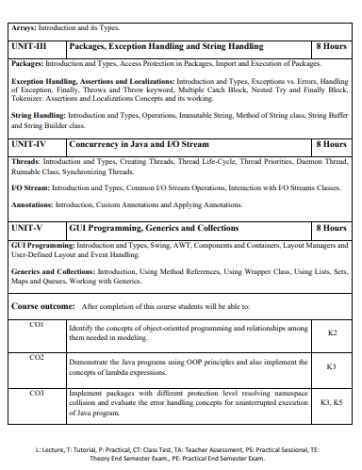
Syllabus

Slide 13
Branch wise Applications
Desktop GUI Applications
Mobile Applications
Enterprise Applications
Scientific Applications
Web-based Applications
Embedded Systems
Big Data Technologies

Slide 14
Course Objective
The objective of this course is to understand the object-oriented methodology and its techniques to design and develop conceptual models and demonstrate the standard concepts of object-oriented techniques modularity, I/O, and other standard language constructs.
The basic objective of this course is to understand the fundamental concepts of object-oriented programming in Java language and implement the Multithreading concepts, GUI based application and collection framework.

Slide 15
Course Outcome
SEMESTER | COURSE | S.NO | DESCRIPTION | Bloom’s Taxonomy Level
2nd Semester | Object Oriented Techniques with Java | CO1 | Identify the concepts of object-oriented programming and relationships among them needed in modeling. | K2
 |  | CO2 | Demonstrate the Java programs using OOP principles and implement the concepts of lambda expressions. | K3
 |  | CO3 | Implement packages with different protection level resolving namespace collision and evaluate the error handling concepts for uninterrupted execution of Java program. | K3, K5
 |  | CO4 | Implement Concurrency control, I/O Streams and Annotations concepts by using Java program. | K3
 |  | CO5 | Design and develop the GUI based application, Generics and Collections in Java programming language to solve the real-world problem | K6

Slide 16
Program Outcome
1. Engineering knowledge.
2. Problem analysis:
3. Design/development of solutions:
4. Conduct investigations of complex problems:
5. Modern tool usage:.
6. The engineer and society:
7. Environment and sustainability:
8. Ethics:
9. Individual and team work:
10. Communication
11. Project management and finance
12. Life-long learning

Slide 17
CO-PO Mapping
Mapping of Course Outcomes and Program Outcomes:
 | PO1 | PO2 | PO3 | PO4 | PO5 | PO6 | PO7 | PO8 | PO9 | PO10 | PO11 | PO12
CO.1 | 3 | 3 | 3 | 2 | 1 |  |  |  | 2 |  |  | 3
CO.2 | 3 | 3 | 3 | 2 | 1 |  |  |  | 2 |  |  | 3
CO.3 | 3 | 3 | 3 | 2 | 1 |  |  |  | 2 |  |  | 3
CO.4 | 3 | 3 | 3 | 2 | 1 |  |  |  | 2 |  |  | 3
CO.5 | 3 | 3 | 3 | 2 | 1 |  |  |  | 2 |  |  | 3
3= High, 2=Medium, 1=Low

Slide 18
CO- PSO Mapping
 | PSO1 | PSO2 | PSO3 | PSO4
Co.1 | 2 | 3 | 2 | 1
CO.2 | 2 | 3 | 2 | 1
CO.3 | 2 | 3 | 2 | 1
CO.4 | 2 | 3 | 2 | 1
CO.5 | 2 | 3 | 2 | 1
3= High, 2=Medium, 1=Low

Slide 19
Program Specific Outcomes(PSO)
On successful completion of graduation degree the Engineering
graduates will be able to:
PSO1: The ability to identify, analyze real world problems and design
their ethical solutions using artificial intelligence, robotics,
virtual/augmented reality, data analytics, block chain technology,
and cloud computing.
PSO2:The ability to design and develop the hardware sensor devices
and related interfacing software systems for solving complex
engineering problems.
PSO3:The ability to understand inter disciplinary computing
techniques and to apply them in the design of advanced computing.
PSO4: The ability to conduct investigation of complex problem with
the help of technical, managerial, leadership qualities, and modern engineering tools provided by industry sponsored laboratories.

Slide 20
Prerequisite and Recap
Student must know at least the basics of how to use a computer and should be able to start a command line shell.
Knowledge of basic programming concepts, as covered in ‘Programming Basic” course is necessary.

Slide 21
Content
Object Oriented Programming
Introduction and Features
Abstraction
Encapsulation
Polymorphism
Inheritance
Modeling Concepts
Class Diagram
Object Diagram
Control Statements
Decision Making
Looping
Branching
Argument Passing Mechanism
Command Line Argument

Slide 22
Objective of Unit
This course gives the fundamental knowledge of basic OOPS concept.
The unit will help the students to understand how the approaches of OOPS helps in solving complex problems
Basic understanding of modeling used.
Overview of control statements and using them in programs.

Slide 23
Object Oriented Programming : Introduction
The main aim of OOP is to bind together the data and the functions that operate on them so that no other part of the code can access this data except that function.
In the object-oriented paradigm, the list and the associated operations are treated as one entity known as an object.
The striking features of OOP include the following:
The programs are data centered.
Programs are divided in terms of objects and not procedures.
Functions that operate on data are tied together with the data.

Slide 24
Object Oriented Programming : Introduction
Data is hidden and not accessible by external functions.
New data and functions can be easily added as and when required.
Follows a bottom-up approach for problem solving.

Slide 25
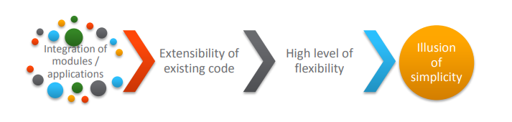
Object Oriented Programming : Introduction
Need for Object Oriented Approach
Challenges in developing a business application.
If these challenges are not addressed, it may lead to software crisis

Slide 26
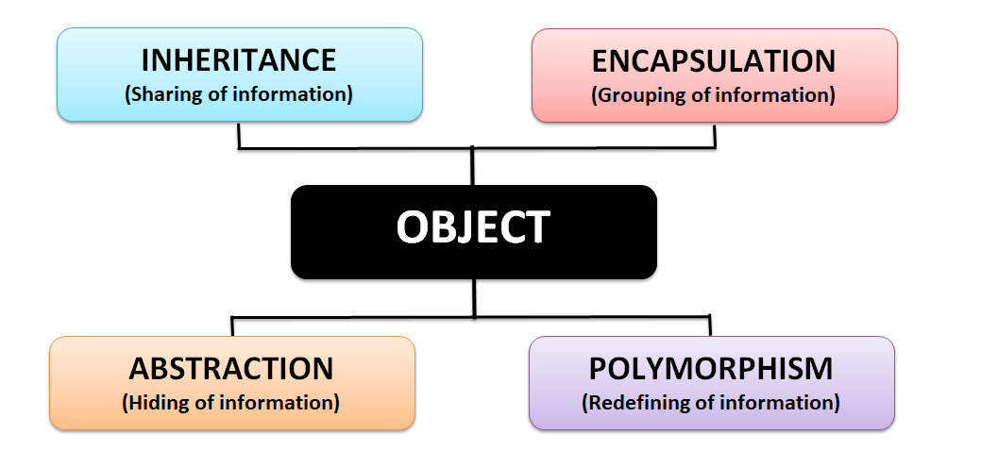
Object Oriented Programming : Features

Slide 27
Abstraction
Abstraction is a process of hiding the implementation details from the user, only the functionality will be provided to the user.
In other words, the user will have the information on what the object does instead of how it does.
Example 1 : when you login to your Amazon account online, you enter your user id and password and press login, what happens when you press login, how the input data sent to amazon server, how it gets verified is all abstracted away from the you.
Example 2 : A car is a well-defined object, which is composed of several other smaller objects like a gearing system, steering mechanism, engine, which are again have their own subsystems. But for humans, car is a one single object, which can be managed by the help of its subsystems, even if their inner details are unknown.

Slide 28
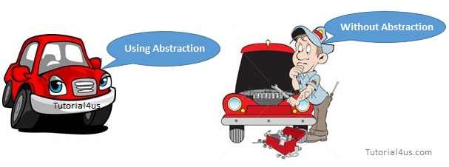
Abstraction

Slide 29
Encapsulation
Binding the data with the code that manipulates it.
It keeps the data and the code safe from external interference
Example :-
A power steering mechanism of a car.
Power steering of a car is a complex system, which internally have lots of components tightly coupled together, they work synchronously to turn the car in the desired direction.
It even controls the power delivered by the engine to the steering wheel.
But to the external world there is only one interface is available and rest of the complexity is hidden.
Moreover, the steering unit is complete and independent. It does not affect the functioning of any other mechanism.

Slide 30
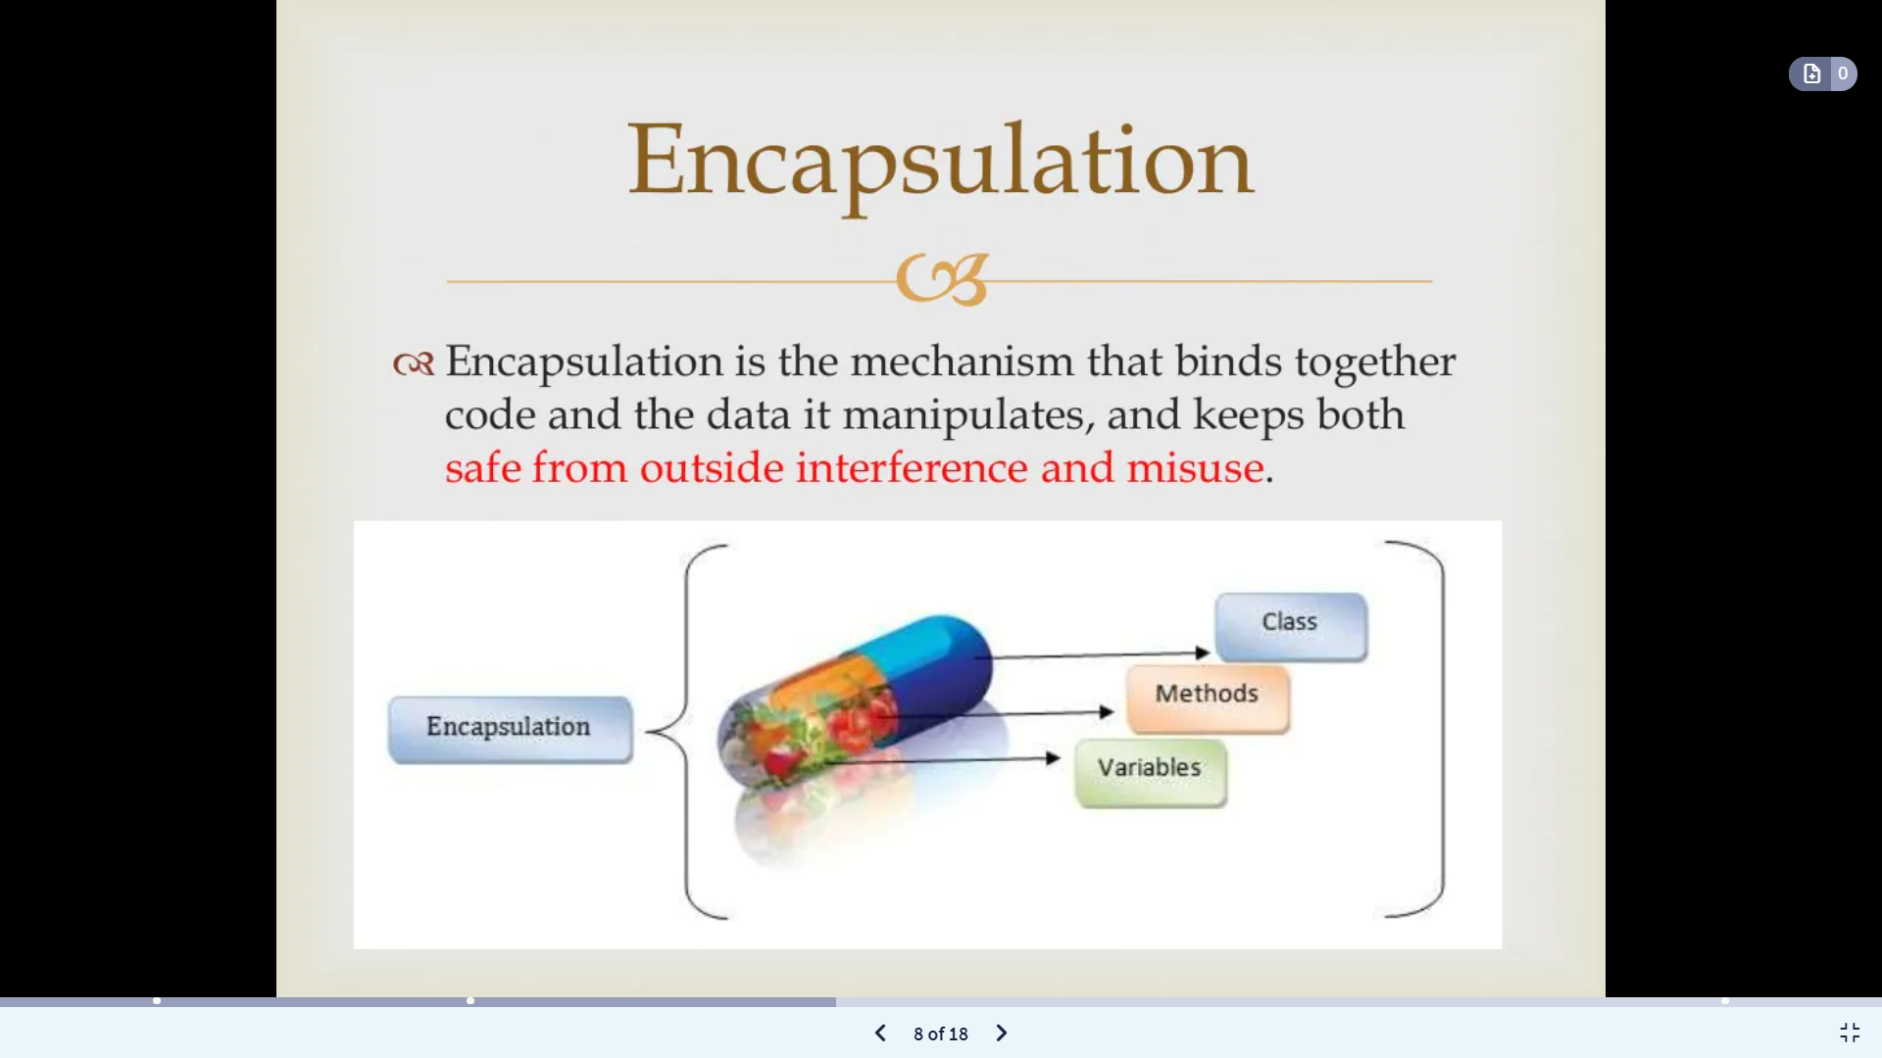
Encapsulation

Slide 31
Polymorphism
Polymorphism is a word that came from two Greek words, poly means many and morphos means forms.
If a variable, object or method perform different behavior according to situation, it is called polymorphism.
Example of a car
A car have a gear transmission system.
It has four front gears and one backward gear.
When the engine is accelerated then depending upon which gear is engaged different amount power and movement is delivered to the car.
The action is same applying gear but based on the type of gear the action behaves differently or you can say that it shows many forms (polymorphism means many forms)

Slide 32
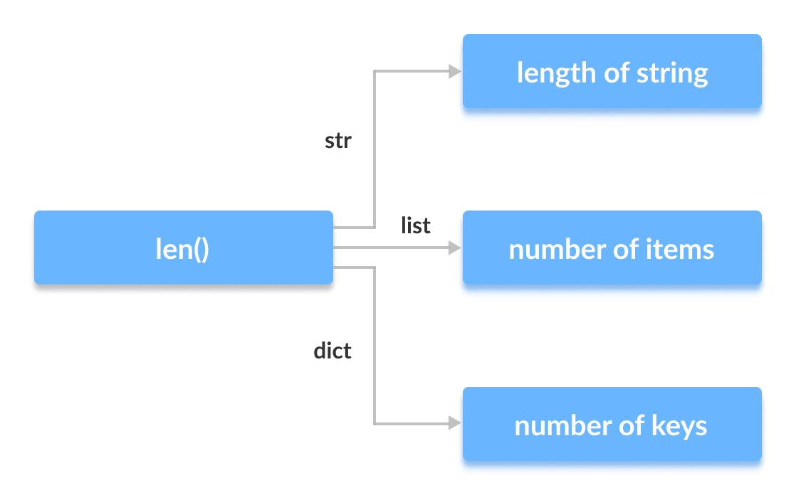
Polymorphism

Slide 33
Inheritance
The mechanism of deriving a new class from an old one (existing class) such that the new class inherit all the members (variables and methods) of old class is called inheritance or derivation.
A class that is derived from another class is called a subclass (also a derived class, extended class or child class)
The class from which the subclass is derived is called a super class or base class or parent class

Slide 34
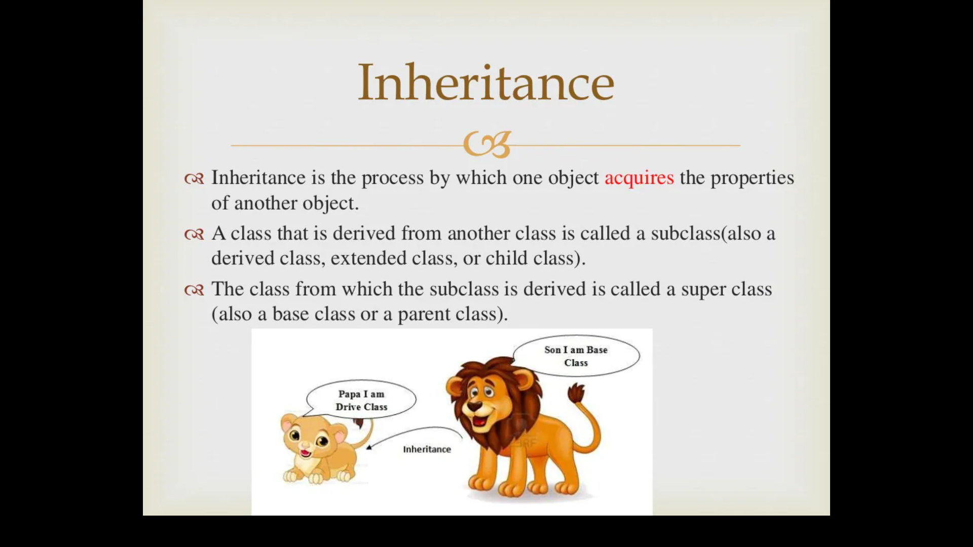
Inheritance
The old class is referred to as the Super class and the new one is called the Sub class.
Parent Class - Base Class or Super Class
Child Class - Derived Class or Sub Class

Slide 35
Inheritance
For example:
Car is a four wheeler vehicle so assume that we have a class FourWheeler and a sub class of it named Car. Here Car acquires the properties of a class FourWheeler. Other classifications could be a jeep, van etc.
FourWheeler defines a class of vehicles that have four wheels, and specific range of engine power, load carrying capacity etc.
Car (termed as a sub-class) acquires these properties from FourWheeler, and has some specific properties, which are different from other classifications of FourWheeler, such as luxury, comfort, shape, size, usage etc.
A car can have further classification such as an open car, small car, big car etc, which will acquire the properties from both Four Wheeler and Car, but will still have some specific properties.

Slide 36
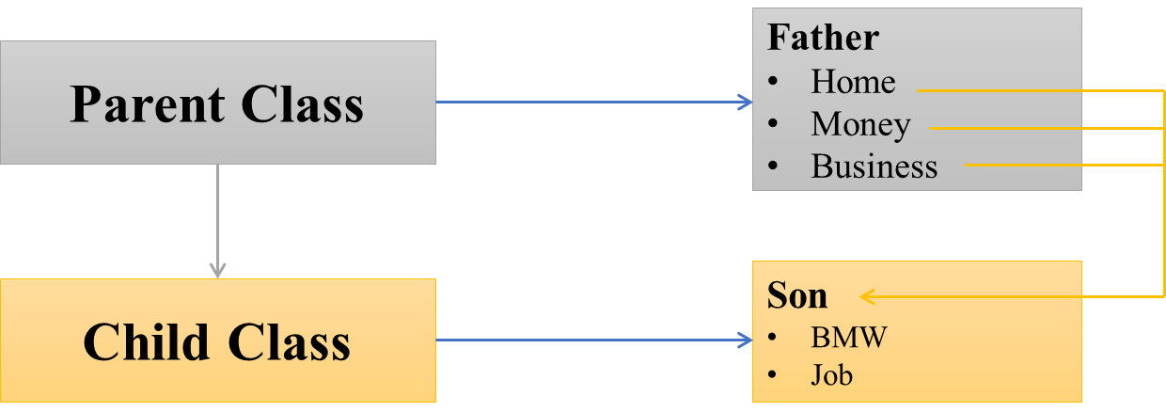
Inheritance
Inheritance has a lot of benefits :
Extensibility
Reusability
Provide abstraction
Eliminates redundant code

Slide 37
Modeling Concepts : Introduction
Object-oriented modeling and design is a way of thinking about problems using models organized around real-world concepts.
The fundamental construct is the object, which combines both data structure and behavior.
Object-oriented modeling (OOM) is the construction of objects using a collection of objects that contain stored values of the instance variables found within an object.
Unlike models that are record-oriented, object-oriented values are solely objects.
The object-oriented modeling approach creates the union of the application and database development and transforms it into a unified data model and language environment.
Object-oriented modeling allows for object identification and communication while supporting data abstraction, inheritance and encapsulation.

Slide 38
Class Diagrams
Class diagram is a static diagram. It represents the static view of an application.
Class diagram is not only used for visualizing, describing, and documenting different aspects of a system but also for constructing executable code of the software application.
It is the only diagram that is widely used for construction, and it can be mapped with object-oriented languages.
Following are the purpose of class diagrams given below:
It analyses and designs a static view of an application.
It describes the major responsibilities of a system.
It is a base for component and deployment diagrams.
It incorporates forward and reverse engineering.

Slide 39
Class Diagrams
The following points should be remembered while drawing a class diagram:
The name of the class diagram should be meaningful to describe the aspect of the system.
Each element and their relationships should be identified in advance.
Responsibility (attributes and methods) of each class should be clearly identified
For each class, minimum number of properties should be specified, as unnecessary properties will make the diagram complicated.

Slide 40
Class Diagrams
Use notes whenever required to describe some aspect of the diagram. At the end of the drawing it should be understandable to the developer/coder.
Finally, before making the final version, the diagram should be drawn on plain paper and reworked as many times as possible to make it correct.

Slide 41
Class Diagrams
Attributes
An attribute is a named property of a class that describes a range of values that instances of the property may hold.
A class may have any number of attributes or no attributes at all.
An attribute represents some property of the thing you are modeling that is shared by all objects of that class.

Slide 42
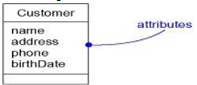
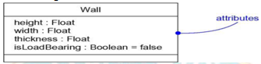
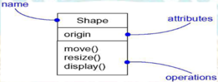
Class Diagrams

Slide 43
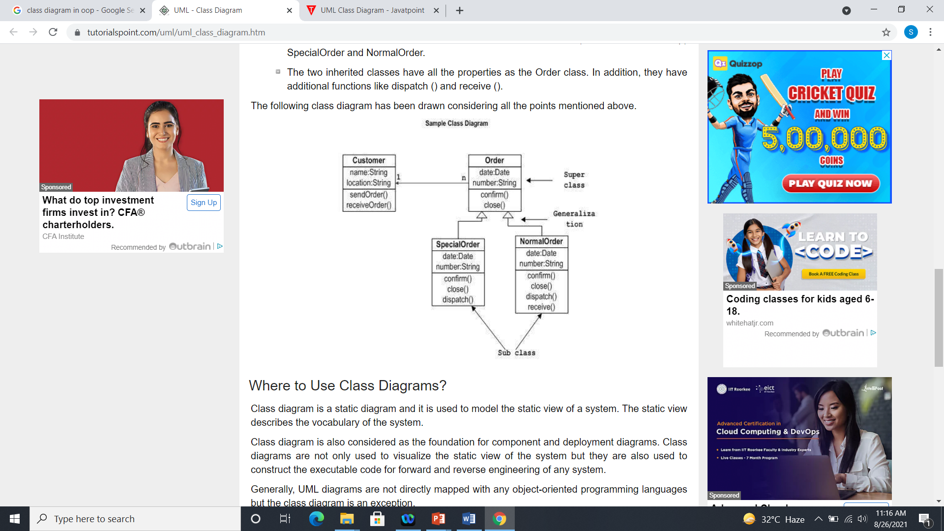
Class Diagrams
The following diagram is an example of an Order System of an application. It describes a particular aspect of the entire application.

Slide 44
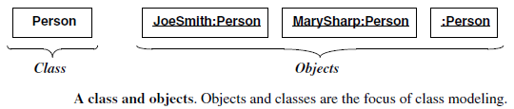
Object Diagrams
Object
An object is a concept, abstraction, or thing with identity that has meaning for an application.
Objects often appear as proper nouns or specific references in problem descriptions and discussions with users.
Some objects have real-world entity like table, tree etc.

Slide 45
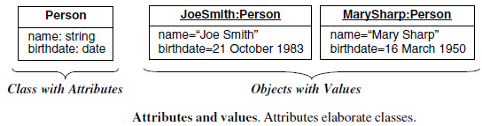
Object Diagrams
Attribute and Value of an object
Each attribute is associated a specific value.

Slide 46
Object Diagrams
Object diagrams are derived from class diagrams so object diagrams are dependent upon class diagrams.
Object diagrams also represent the static view of a system but this static view is a snapshot of the system at a particular moment.
The purpose of the object diagram can be summarized as
Forward and reverse engineering.
Object relationships of a system
Static view of an interaction.
Understand object behavior and their relationship from practical perspective

Slide 47
Object Diagrams
The following things should be remembered and understood clearly:
Object diagrams consist of objects.
The link in object diagram is used to connect objects.
Objects and links are the two elements used to construct an object diagram.
The object diagram should have a meaningful name to indicate its purpose.
The most important elements are to be identified.
The association among objects should be clarified.
Values of different elements need to be captured to include in the object diagram.
Add proper notes at points where more clarity is required.

Slide 48
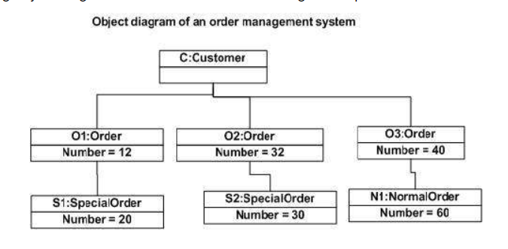
Object Diagrams
The following diagram is an example of an object diagram. It represents the Order management system

Slide 49
Control Statements
Java compiler executes the code from top to bottom.
The statements in the code are executed according to the order in which they appear.
However, java provides statements that can be used to control the flow of Java code. Such statements are called control flow statements.
Java provides three types of control flow statements:
Decision Making statements
Loop statements
Jump statements

Slide 50
Decision Making
Decision-making statements decide which statement to execute and when.
Decision-making statements evaluate the Boolean expression and control the program flow depending upon the result of the condition provided.

Slide 51
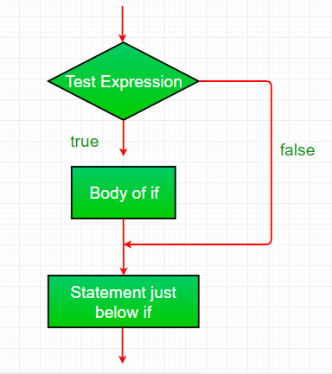
Decision Making
If Statement:
In Java, the "if" statement is used to evaluate a condition. The control of the program is diverted depending upon the specific condition.

Slide 52
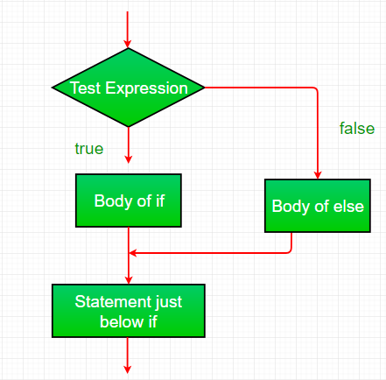
Decision Making
If-else:
We can use the else statement with if statement to execute a block of code when the condition is false.

Slide 53
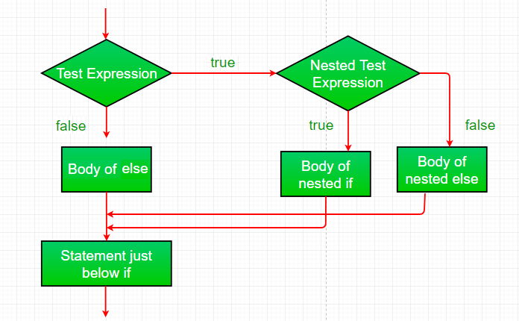
Decision Making
Nested-if:
A nested if is an if statement that is the target of another if or else. Nested if statements means an if statement inside an if statement.

Slide 54
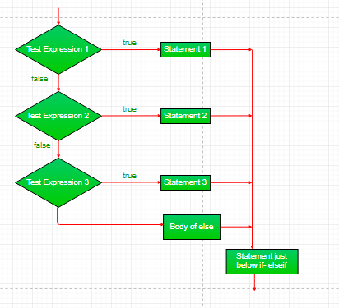
Decision Making
If-else-if-ladder:
If statements are executed from the top down.
As soon as one of the conditions controlling the if is true, the statement associated with that if is executed, and the rest of the ladder is bypassed.

Slide 55
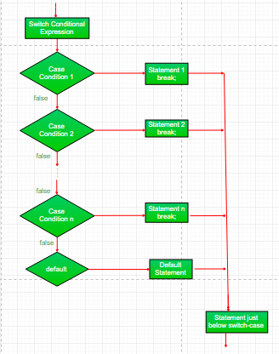
Decision Making
Switch statement :
The switch statement is a multiway branch statement. It provides an easy way to dispatch execution to different parts of code based on the value of the expression.

Slide 56
Looping
The Java for loop is used to iterate a part of the program several times
Java provides three ways for executing the loops
While
Do.. while
For

Slide 57
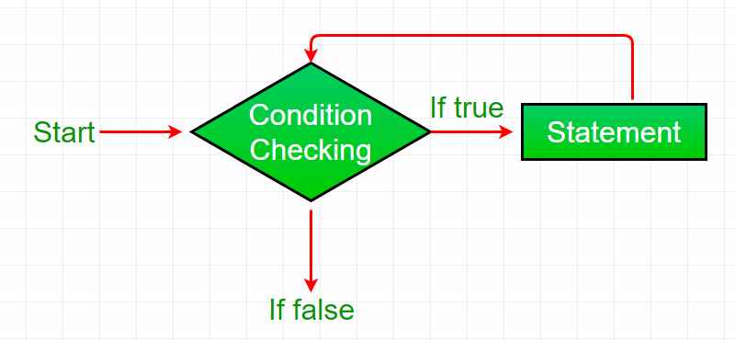
Looping
While loop:
A while loop is a control flow statement that allows code to be executed repeatedly based on a given Boolean condition. The while loop can be thought of as a repeating if statement.
While loop starts with the checking of condition. If it evaluated to true, then the loop body statements are executed otherwise first statement following the loop is executed. For this reason it is also called Entry control loop

Slide 58
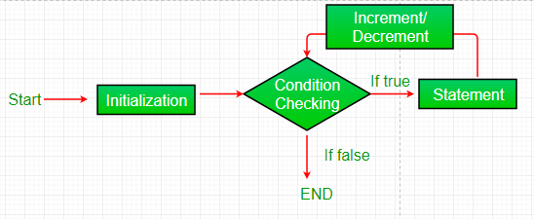
Looping
For loop:
For loop provides a concise way of writing the loop structure.
Unlike a while loop, a for statement consumes the initialization, condition and increment/decrement in one line thereby providing a shorter, easy to debug structure of looping.

Slide 59
Looping
Initialization condition: Here, we initialize the variable in use. It marks the start of a for loop.
An already declared variable can be used or a variable can be declared, local to loop only.
Testing Condition: It is used for testing the exit condition for a loop. It must return a Boolean value.
It is also an Entry Control Loop as the condition is checked prior to the execution of the loop statements.
Statement execution: Once the condition is evaluated to true, the statements in the loop body are executed.
Increment/ Decrement: It is used for updating the variable for next iteration.
Loop termination: When the condition becomes false, the loop terminates marking the end of its life cycle.

Slide 60
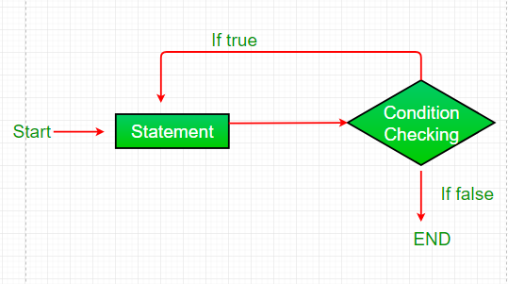
Looping
Do-while:
Do while loop is similar to while loop with only difference that it checks for condition after executing the statements, and therefore is an example of Exit Control Loop.
Do while loop starts with the execution of the statement(s). There is no checking of any condition for the first time.

Slide 61
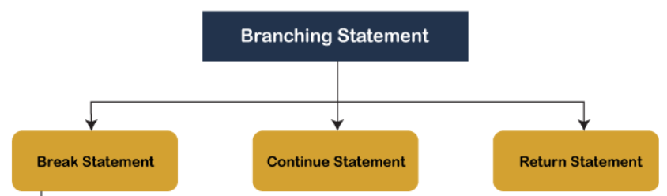
Branching
Branching statements are the statements used to jump the flow of execution from one part of a program to another.
The branching statements are mostly used inside the control statements.

Slide 62
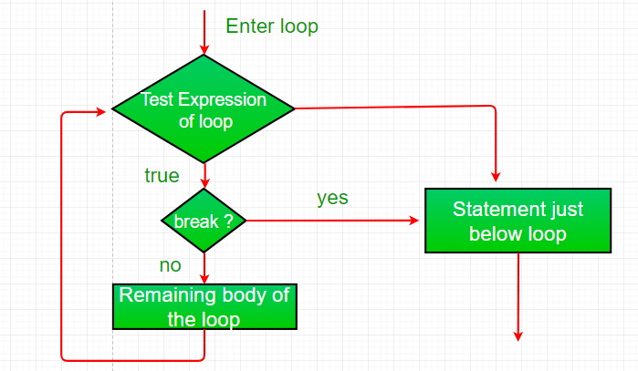
Branching
The break Statement
Using break, we can force immediate termination of a loop, bypassing the conditional expression and any remaining code in the body of the loop.

Slide 63
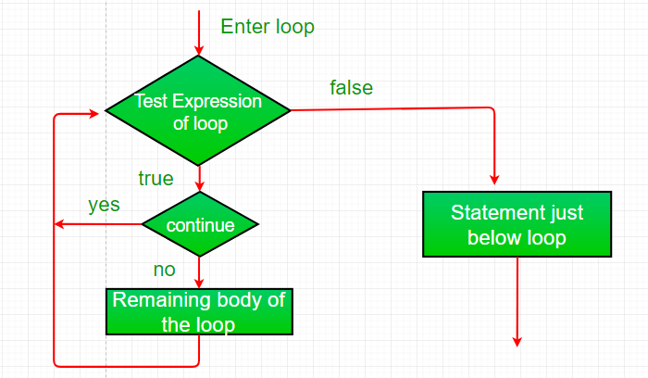
Branching
Continue:
Sometimes it is useful to force an early iteration of a loop. That is, you might want to continue running the loop but stop processing the remainder of the code in its body for this particular iteration.

Slide 64
Branching
Return:
The return statement is used to explicitly return from a method. That is, it causes a program control to transfer back to the caller of the method.

Slide 65
Argument Passing Mechanism
Arguments in Java are always passed-by-value.
During method invocation, a copy of each argument, whether its a value or reference, is created in stack memory which is then passed to the method.
When we pass an object, the reference in stack memory is copied and the new reference is passed to the method.

Slide 66
Command Line Arguments
Command line argument is a parameter supplied to the program when it is invoked.
Command line argument is an important concept in programming.
It is mostly used when you need to control your program from outside.
Command line arguments are passed to the main() method.

Slide 67
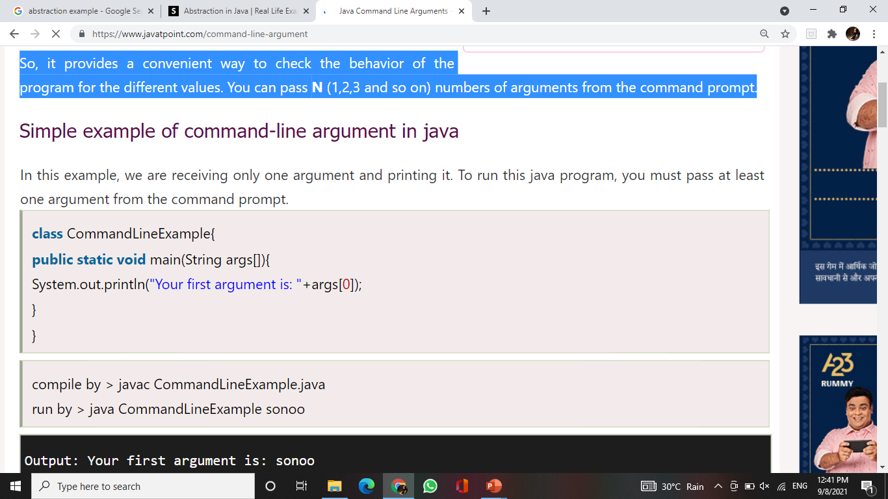
Command Line Arguments
The java command-line argument is an argument i.e. passed at the time of running the java program.
The arguments passed from the console can be received in the java program and it can be used as an input.
So, it provides a convenient way to check the behavior of the program for the different values. You can pass N (1,2,3 and so on) numbers of arguments from the command prompt.
Example:

Slide 68
Command Line Arguments
Parsing is the process of turning some kind of data into another kind of data.
Moving towards more technical explanation, Parsing refers to the process of analyzing some input to determine whether it belongs to a specific language, i.e. if it is ‘syntactically valid’ for that language's grammar or not.
Very simple examples of parsing are:
Recognizing that the integer value represented by the string “123” is the number 123
Recognizing the date represented in the string “1/2/2000”

Slide 69
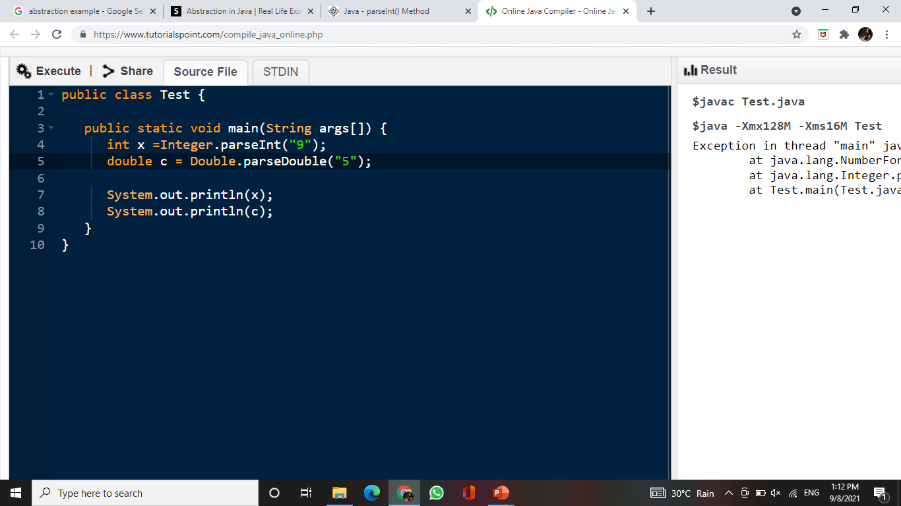
Command Line Arguments
Example:

Slide 70
Daily Quiz
1. Which of the following is not OOPS concept in Java? a) Inheritance b) Encapsulation c) Polymorphism d) Compilation
2. Which of the following is a type of polymorphism in Java? a) Compile time polymorphism b) Execution time polymorphism c) Multiple polymorphism d) Multilevel polymorphism
3. Which concept of Java is a way of converting real world objects in terms of class? a) Polymorphism b) Encapsulation c) Abstraction d) Inheritance

Slide 71
Daily Quiz
4. Which of the following is not an OOPS concept?
a. Encapsulation
b.Polymorphism
c.Exception
d.Abstraction
5. Which feature of OOPS described the reusability of code?
a. Abstraction
b.Encapsulation
c.Polymorphism
d.Inheritance
6.Which feature of OOPS derives the class from another class?
a. Inheritance
b.Data hiding
c.Encapsulation
d.Polymorphism

Slide 72
Daily Quiz
7. An IF-ELSE statement is also called ___.
a. Branching statement
b. Control statement
c. Block statements
d. All
8.Which of these jump statements can skip processing the remainder of the code in its body for a particular iteration?
a. Break
b.Return
c.Exit
d.continue

Slide 73
Daily Quiz
9. Every loop in Java has a condition that should be ___ in order to proceed for execution. (TRUE / FALSE)
A) FALSE
B) TRUE
10. What is a Loop in Java programming language?
A) A Loop is a block of code that is executed repeatedly as long as a condition is satisfied.
B) A Loop is a block of code that is executed only once if the condition is satisfied.
C) A Loop is a block of code that is executed more than 2 times if the condition is satisfied.
D) None

Slide 74
Weekly Assignment
Q1. State some of object oriented technique strategies.
Q2.Draw the class diagram of Online Shopping System.
Q3.Discuss Inheritance and polymorphism with Example.
Q4.Differentiate between Break and Continue statement.
Q5.Describe Object Diagram with suitable example.
Q6.Define if-else-if ladder with short program.
Q7.Describe the control flow statement and types of control flow statements.
Q8.Explain branching statements in Java with suitable examples.
Q9. Explain Encapsulation with example.
Q10. Draw class diagram of online library management system.

Slide 75
Topic Links
https://www.youtube.com/watch?v=r59xYe3Vyks&list=PLS1QulWo1RIbfTjQvTdj8Y6yyq4R7g-Al
https://www.digimat.in/nptel/courses/video/106105191/L01.html

Slide 76
MCQs
Q1. Which of these are selection statements in Java? a) if() b) for() c) continue d) break
Q2. Which of this statement is incorrect? a) switch statement is more efficient than a set of nested ifs b) two case constants in the same switch can have identical values c) switch statement can only test for equality, whereas if statement can evaluate any type of Boolean expression d) it is possible to create a nested switch statements
Q3. Which of these selection statements test only for equality? a) if b) switch c) if & switch d) none of the mentioned

Slide 77
MCQs
Q4. switch(x){ default: System.out.println(“Hello”); }
Which of the following is acceptable types for x? (i) byte and char
(ii) char and float
(iii) float and double
(iv) double and int
Q5.An IF statement in Java is also a ___ statement.
A) Boolean
B) conditional
C) iterative
D) Optional
Q6.What is the output of the Java program with IF-ELSE statements?
if(TRUE) System.out.println("GO"); else System.out.println("STOP");
A) GO
B) STOP
C) Compiler error
D) None

Slide 78
MCQs
Q7.What is the output of the Java program?
int a=10; if(a==9)
System.out.println("OK ");
System.out.println("MASTER"); else System.out.println("BYE");
A) OK MASTER
B) BYE
C) Compiler error
D) None
Q8.What is the output of the Java program with IF-ELSE-IF statements?
int marks=55; if(marks >= 80)
System.out.println("DISTINCTION");
else if(marks >=35)
System.out.println("PASS");
else
System.out.println("FAIL");

Slide 79
MCQs
A) DISTINCTION
B) PASS
C) FAIL
D) Compiler error
Q9.What is the output of Java program below?
float temp = 98.4f;
if(temp > 98.4)
{
System.out.println("SUMMER");
}
Else
{ System.out.println("UNKNOWN");
}

Slide 80
MCQs
A) SUMMER
B) UNKNOWN
C) Compiler error
D) None
Q10. What is the output of the Java program below?
if(3>1) { 4; }
A) 0
B) 4
C) Compiler error
D) None

Slide 81
Thank You

